Slide 1
Mastering the Fundamentals of DevSecOps
Part #2

Slide 2
OUTLINE
Mastering the Fundamentals of DevSecOps part #2
RECAP
Hands-On
CLOSING
What have we been going through so far?
Focus on Ops tasks
Q&A

Slide 3
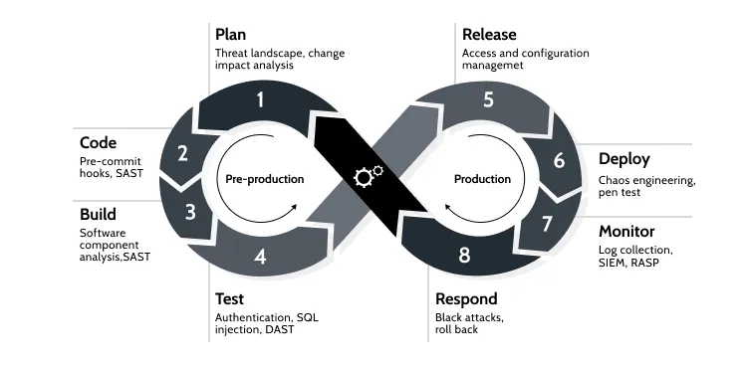
RECAP: DevSEcOps

Slide 4
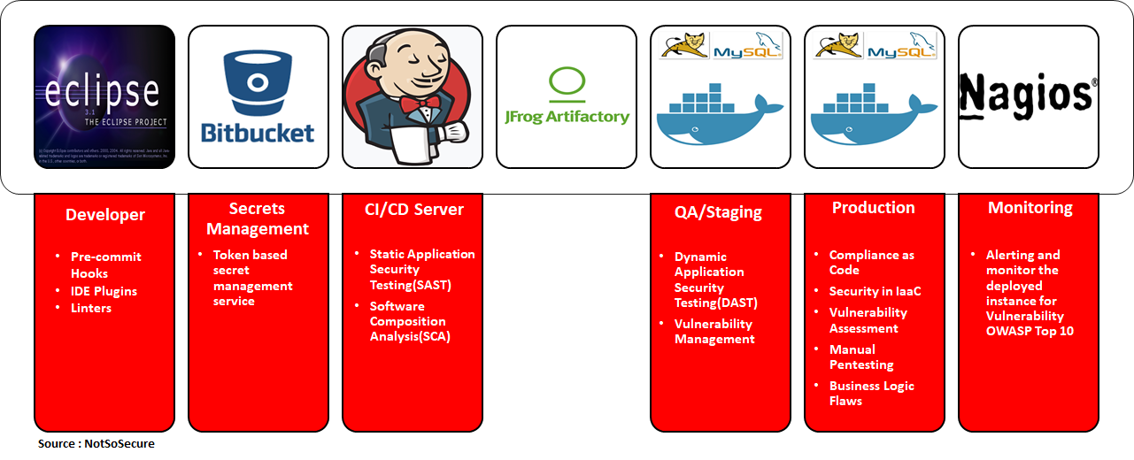
RECAP: DevSecOps Pipeline

Slide 5
RECAP: HANDS-ON part #1
IDE Setup - SonarLint
Git Hooks – Talisman
Secret managements
Software Composition Analysis (SCA): dependency checks
Static Analysis Security Testing (SAST): SonarQube

Slide 6
HANDS-ON part #2: focus on Ops
Config check
Image check
Deployment environment check
Deployed app check

Slide 7
PROBLEM
MARKET GAP
COSTS
Natural building materials continue to be consumer driven, but we're seeing a lapse of availability in the market for these products
Loss of sales by not offering greener alternatives to building materials
CUSTOMERS
USABILITY
25% increase of buildings that are energy efficient proves that there's consumer interest for more green building design
Customers want their spaces to be stylish, but also energy efficient
FINANCIALS
Commercial architecture sales were up by $10 million in 2020

Slide 8
Config Check
Dockerfile - Conftest
Installation – Conftest
gbrindisi/dockerfile-security: A collection of OPA rules to statically analyze Dockerfiles to improve security (github.com)
conftest test --policy dockerfile-security.rego Dockerfile
Kubernetes - Kubesec
curl -sSX POST --data-binary @»redis-leader.yaml» https://v2.kubesec.io/scan
docker run -i kubesec/kubesec:512c5e0 scan /dev/stdin < redis-leader.yaml
Trivy: let me handle all that!
aquasecurity/trivy: Find vulnerabilities, misconfigurations, secrets, SBOM in containers, Kubernetes, code repositories, clouds and more (github.com)
Install Trivy
Installation - Trivy (aquasecurity.github.io)
Using Trivy
trivy conf ./

Slide 9
Image Check
Use
trivy image image-name:the-tag

Slide 10
Deployment Environment Check
Trivy
Kubernetes - Trivy (aquasecurity.github.io)
trivy k8s --report=summary cluster
Install
Installation - Trivy (aquasecurity.github.io)
Use
trivy image image-name:the-tag

Slide 11
Deployed APP Check
Simple integration test
Use curl to check HTTP code and response of some defined endpoint.
if [[ $(curl -s localhost:8008) =~ "Guestbook" ]]; then echo "OK"; else echo "NOT OK"; fi;
if [[ $(curl -s -o /dev/null -w "%{http_code}" localhost:8008) == "200" ]]; then echo "OK"; else echo "NOT OK"; fi;
Dynamic Application Security Testing (DAST) – OWASP ZAP
ZAP – ZAP Docker Documentation (zaproxy.org)
docker run -v .:/zap/wrk/:rw -t owasp/zap2docker-weekly zap-api-scan.py -t https://api.swatch.msvc.app/swagger/doc.json -f openapi -r zap_report.html

Slide 12
Q&A?
Security is Only as Strong as the Weakest Link

Slide 13
THANK YOU
by: Achmad Zaenuri
for Adinesia

